Slide 1
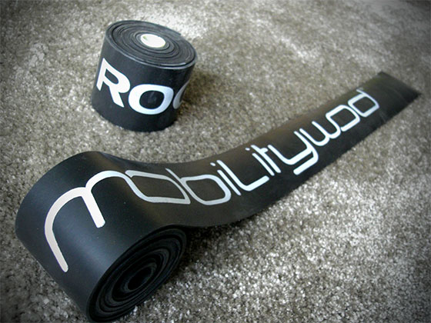
Voodoo Flossing: A Pearl of Practice
Thomas Gooding BS, ATC

Slide 2
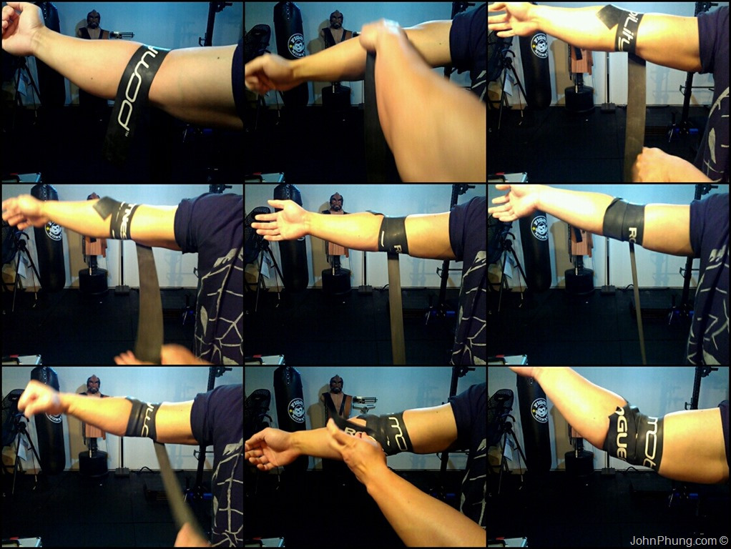
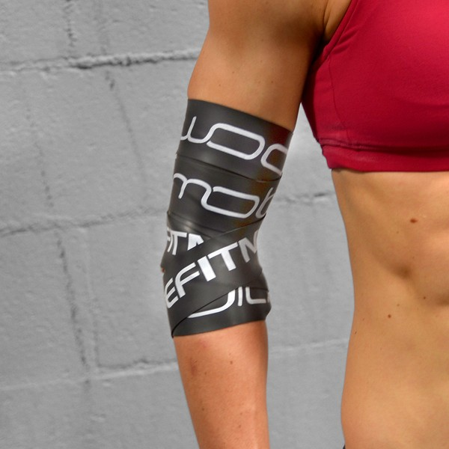
What is this voodoo that you do?

Slide 3
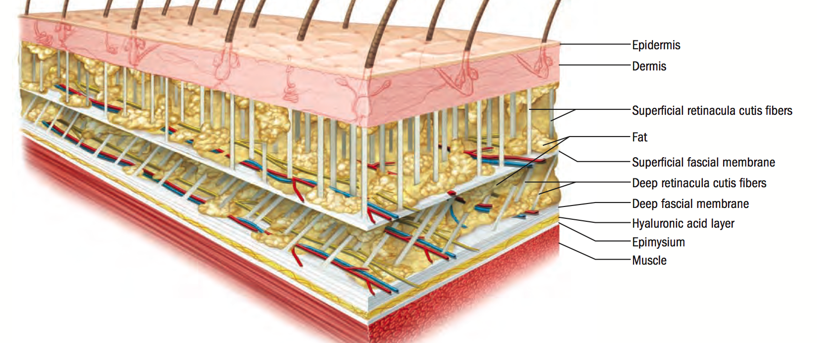
It’s Hip! It’s Now! It Works! But How?

Slide 4
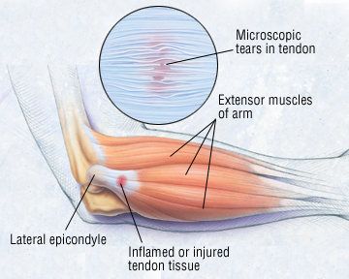
Epicondylitis…No thank you.

Slide 5
Mobing, er I mean, moving on…
Mechanical relocation of the soft tissue (extreme myofascial release)
All about that cross friction of tissue.
“You’re missing the corners in your mobility” - K-star
Let’s talk about epicondylitis
Neural overload sending afferent signals to the brain (pay attention brain!)
Hypoxia
Change in scar tissue formation causing inhibited motion of tissue.
Thought to work essentially the same way as ART.
Notes:
DC says that Graston and foam rolling don’t really provide tissue deformation for myofascial relase, this might?

Slide 6
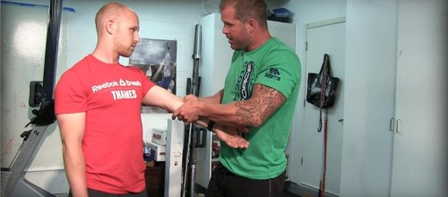
Demonstration
See for yourself! 2:25

Slide 7
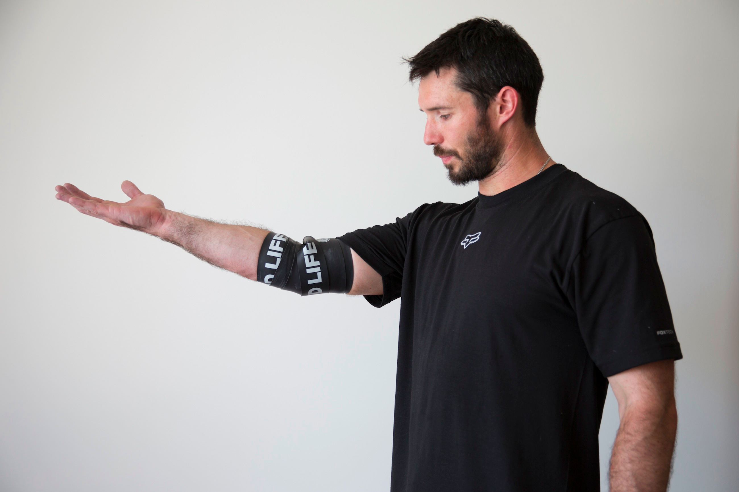
Woah, what do we think?
(Not Keanu Reeves)

Slide 8
Citations
http://therxreview.com/voodoo-floss-bands-review/
Kelly Starrett. Becoming a Supple Leopard. Victory Belt Publishing Inc. Las Vegas, NV. 2013.
Hains, Guy, Martin Descarmeaux, Francois Hains. Chronic Shoulder Pain of Myofascial Origin: A Randomized Clinical Trial Using Ischemic Compression Therapy. J Manipulative and Physiological Therapies. 2011. 33(5): 362-369.
http://www.anguscertified.com/how-to-use-a-voodoo-floss-band/
http://www.activerelease.com/what_patients.asp
Howitt, Scott, Jerome Wong, Sonja Zabukovec. The Conservative Treatment of Trigger Thumb using Graston Techniques and Active Release Techniques. J Canadian Chiropractic Association. 2006. 50(4): 249-254

